Slide 1

Cloud-Based Software Implementation Using DevOps Tools
This presentation outlines the process of implementing cloud-based software using DevOps tools, emphasizing scalability and efficiency.

Slide 2
Objectives
1
Scalable AWS Setup
2
Infrastructure as Code (IaC)
3
Ansible
Optimize infrastructure for handling fluctuating workloads, ensuring high availability and performance (EC2, VPC, S3, ELB)
Automate configuration management and application deployment on servers, streamlining deployment processes and reducing errors.
Automate infrastructure provisioning and configuration using tools like Terraform, ensuring consistency and repeatability.
4
Dockerization
5
Continuous Integration/Continuous Delivery (CI/CD)
Package applications and dependencies into containers, enabling consistent execution across different environments.
Automate the software development lifecycle, from code changes to deployment, ensuring continuous integration and delivery.

Slide 3
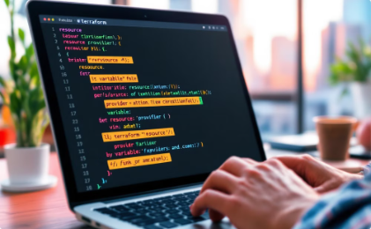
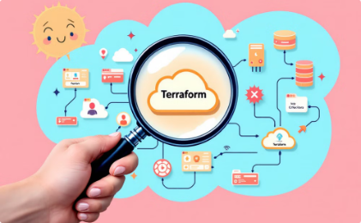
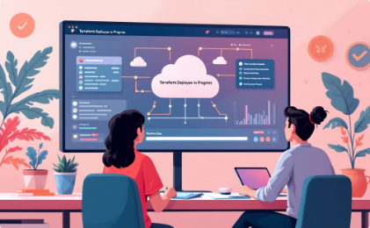
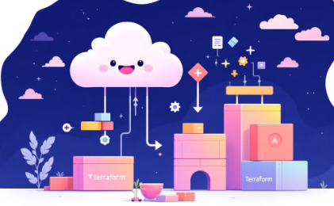

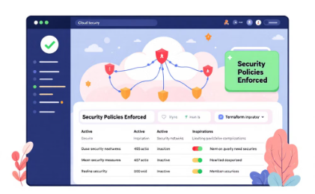

Terraform for Infrastructure as Code
Improved Consistency
Reduced Errors
Faster Deployments
Increased Scalability
Terraform ensures your infrastructure is deployed consistently, reducing configuration drift.
By defining infrastructure as code, you can eliminate manual errors during setup.
Terraform automates provisioning, making deployments faster than manual methods.
Terraform allows you to easily scale your infrastructure up or down as needed, ideal for dynamic environments.
Improved Collaboration
Enhanced Security
Terraform promotes collaboration by providing a shared code base for managing infrastructure.
Terraform can help enforce security policies and best practices during infrastructure deployment.

Slide 4
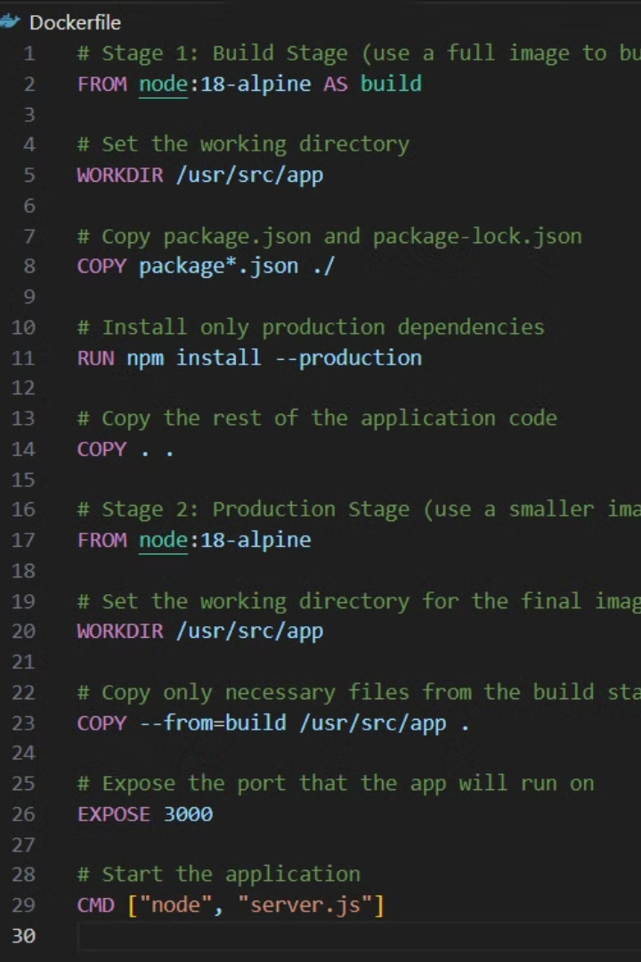
Containerization with Docker
Package Your Application
Isolation and Security
Portability and Scalability
Docker allows you to package your application and its dependencies into a self-contained unit. This ensures that your application runs consistently across different environments.
Containers provide isolation and security by running each application in its own isolated environment, reducing the risk of conflicts and security vulnerabilities.
Containers are portable, allowing you to easily deploy and run your application on different machines or cloud environments. They also make scaling your application up or down simple.

Slide 5

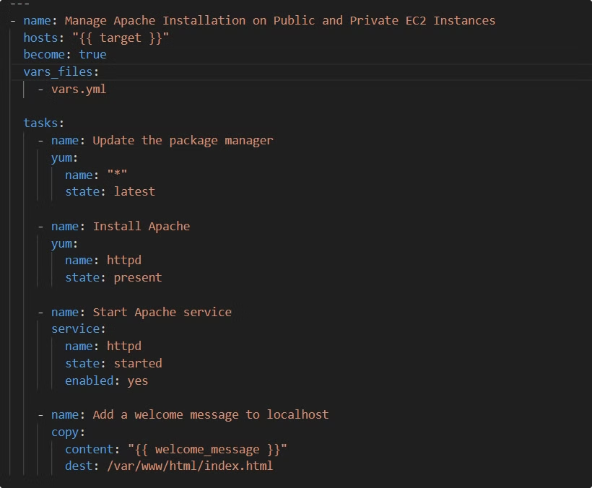



Orchestration with Ansible
Provisioning
Ansible can provision new servers, install software, and configure them according to your specifications. This streamlines the setup process and ensures consistency.
Configuration Management
Ansible manages the configuration of your servers, ensuring that they are consistently configured and meet your desired state. This includes managing software packages, users, and network settings.
Deployment and Orchestration
Ansible orchestrates the deployment of your applications, ensuring that they are deployed in a controlled and predictable manner. This includes managing dependencies, restarting services, and rolling out updates.

Slide 6
3-Tier AWS Architecture
Virtual Private Cloud (VPC)
Elastic Load Balancer (ELB)
Elastic Compute Cloud (EC2)
A private network within AWS, providing secure isolation for resources and applications.
Distributes incoming traffic across multiple EC2 instances, ensuring high availability and fault tolerance.
Virtual servers on AWS, providing flexible and scalable compute resources for applications.

Slide 7

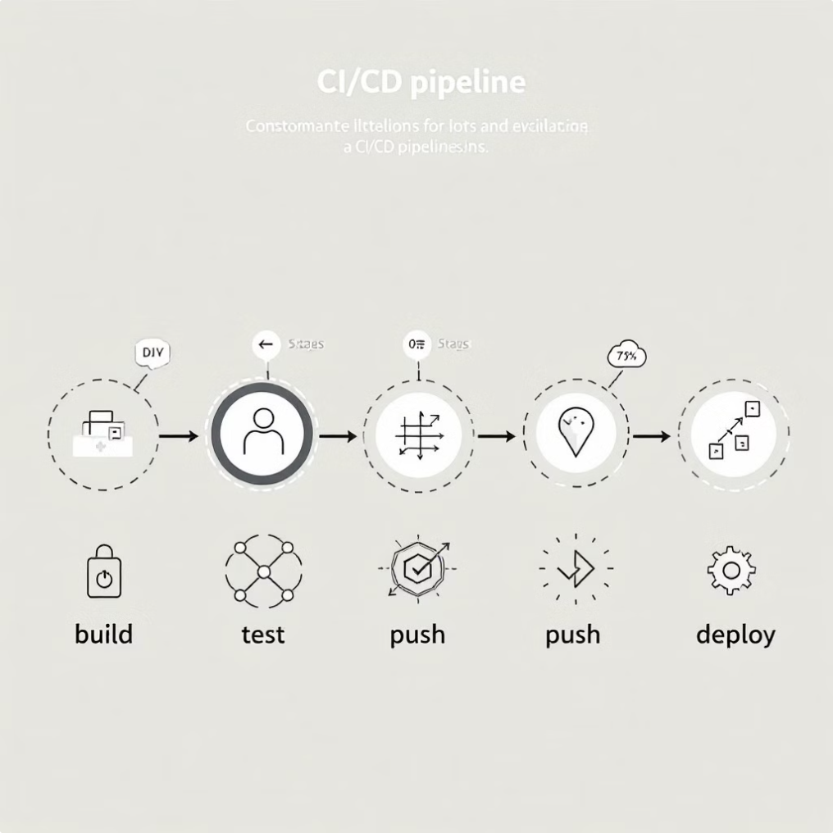
Pipeline Stages
1
Tests
Automated unit, integration, and end-to-end tests are performed to ensure code quality and functionality.
2
Build
The application code is compiled, packaged, and prepared for deployment into Docker containers.
3
Push
The built Docker image is pushed to a container registry, making it available for deployment to the target environment.
4
Deploy
The Docker image is deployed to the target environment (AWS EC2 instances) using tools like Kubernetes or ECS.

Slide 8
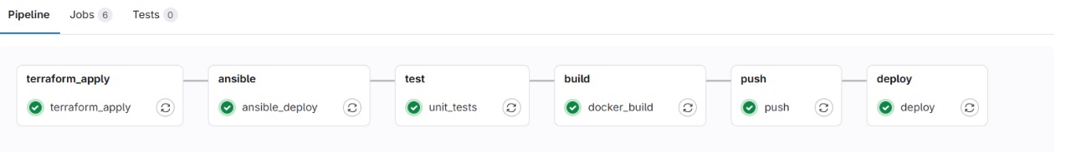

Slide 9
Key Challenges
1
Security
2
Scalability
3
Monitoring & Management
Ensuring secure access to cloud resources and protecting sensitive data is a critical concern.
Dynamically scaling resources to handle fluctuating workloads and maintain performance can be challenging.
Effective monitoring and management of cloud resources and applications is essential for maintaining performance and identifying issues.

Slide 10



Solutions
Security Best Practices
Auto Scaling
Implementing strong authentication, access controls, and encryption measures to protect resources and data.
Leveraging AWS auto-scaling features to automatically adjust resources based on demand, ensuring scalability and performance.
Configuration Management
Implementing configuration management tools like Ansible to ensure consistency across different environments and reduce configuration errors.

Slide 11
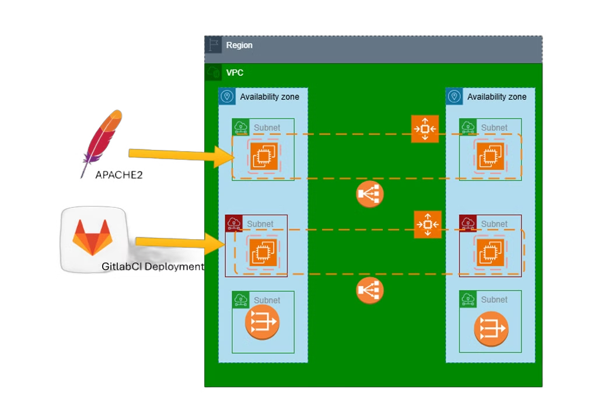




High-Level Architecture
User Interface
Web or mobile application accessible by end-users.
Load Balancer
Distributes traffic across multiple EC2 instances.
Application Servers
EC2 instances running the application code.
Database Server
EC2 instance hosting the database for application data.

Slide 12

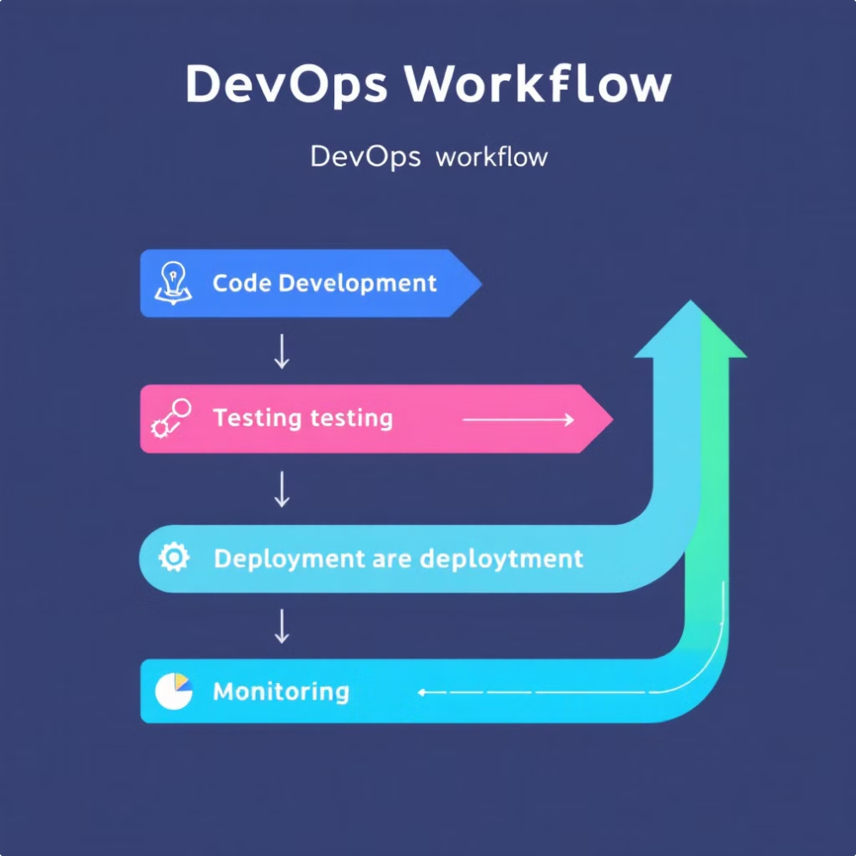
DevOps Workflow
Stage
Description
Code
Developers write and commit code to a version control system.
Build
Automated build processes compile and package the code into deployable artifacts.
Test
Automated tests are run to ensure the code is working as intended.
Deploy
The built artifacts are deployed to the target environment (AWS).
Monitor
Continuous monitoring of the application and infrastructure to ensure performance and identify issues.

Slide 13
Conclusion
1
Scalability and Efficiency
2
Automation and Continuous Delivery
Cloud-based software implementation using DevOps tools delivers scalable and efficient infrastructure for modern applications.
Automating infrastructure provisioning, application deployment, and monitoring ensures fast and reliable delivery of software updates.

Slide 14


Meet Our Team
Mohamed Maged Elsayed
Mohamed Hossam
Mohamed Khaled
Asmaa Maged

Slide 15


